Slide 1
Title

Slide 2
Agenda
Team Introduction
Demo
Industry Research
Product Introduction
Data Collection
Model Iteration
Next Steps

Slide 3
ADSP Capstone Team NULL
Profile Pic Here
Shilong Dai
Snigda Gedela
Takuma Koide
Shefali Gupta
Yif Wang

Slide 4
Demo
Link

Slide 5



LLM Powered Financial Assistants Could Change the Lives of Retail Investors
As Is Scenario of Retail Investors
Market Size (Asset Under Management)
In trillion USD ($)
High cost associated with financial advisors of few hundred dollars per hour or more
Limited time to conduct in depth research and keep up with latest opportunities
Misalignment of advisor interests
CAGR: 9.12%
Gen AI with LLM
Gen AI rapidly analyzes vast data sets, offering insights, reducing the need to manually conduct research and seek opportunities
Gen AI-powered tools, provide financial advice at a fraction of traditional costs
Notes:
https://www.statista.com/outlook/fmo/wealth-management/financial-advisory/united-states

Slide 6
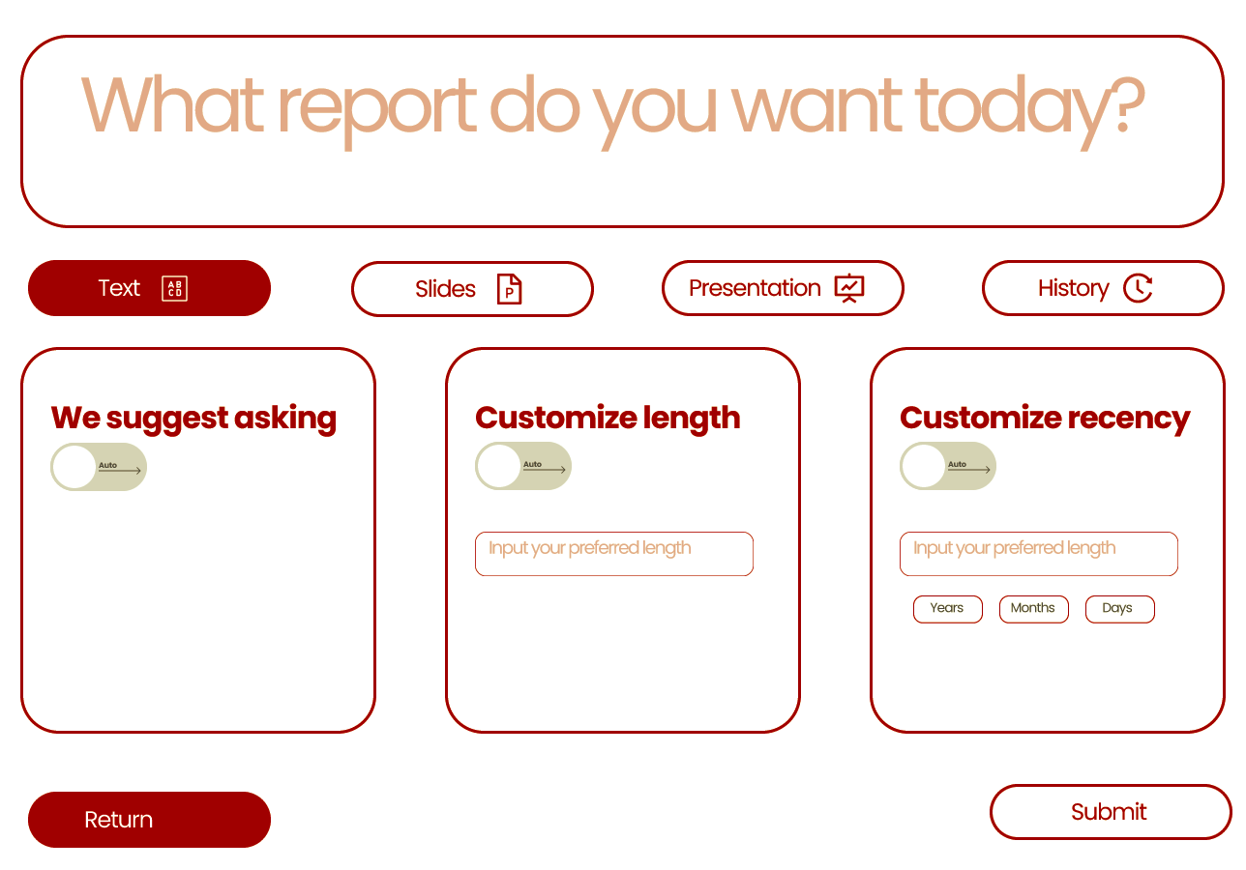
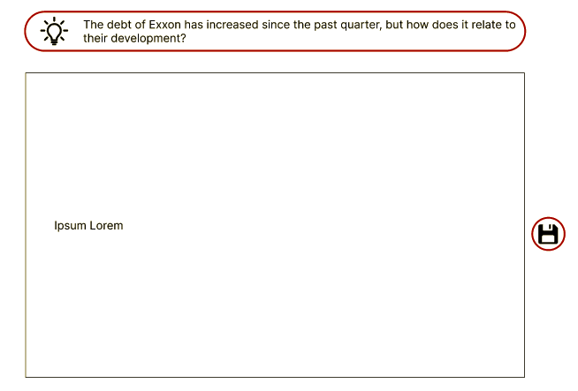
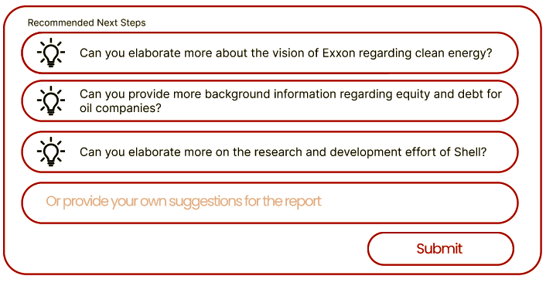

Product Introduction - FinBot
Project Idea
Product Name:
FinBot
Final Product:
AI that takes in user questions or investment ideas and generate answers and suggestions through interactive conversations and (or) visual explanations
UX Flow
1. User specify format of response and ask question
2. User receive report with specified format
3. User ask follow-up questions and interact with FinBot
E

Slide 7
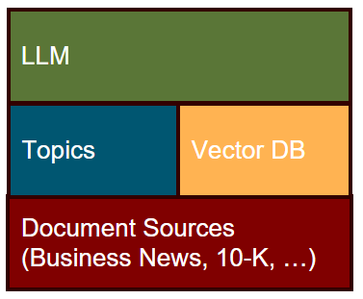
Data Collection
Overview of Current Schematics
Topic based grouping of documents
Vector DB powered document retrieval
Fine-tuned LLM for content synthesis
Document summarization
Topic ranking & interpretation
Report generation

Slide 8
Model

Slide 9
Model Selection

Slide 10
Model Fine Tuning

Slide 11
Next Steps
Constraints
Future Goals

Slide 12

Appendix: MScA team Null Capstone: FinBot
Project Idea
Overview of Current Schematics
Product Name:
FinBot
Final Product:
AI that takes in user questions or investment ideas and generate answers and suggestions through interactive conversations and (or) visual explanations
Topic based grouping of documents
Vector DB powered document retrieval
Fine-tuned LLM for content synthesis
Document summarization
Topic ranking & interpretation
Report generation
UX Flow
1. User specify format of response and ask question
2. User receive report with specified format
3. User ask follow-up questions and interact with FinBot
E
Team Members: Shilong Dai, Yif Wang, Shefali Gupta, Snigda Gedela, Takuma Koide

